Slide 1

Visual Studio Code
(VSCode)
Milo Baker-Durante and Sol Benishay

Slide 2
Topic
Visual Studio Code, created by Microsoft, is a a production-level code editor with support for many languages and extensible functionality that can replicate an IDE environment
According to the “Top IDE Index” (https://pypl.github.io/IDE.html), that is based on how often a tools download page is Google searched, Visual Studio Code ranks #4 in most popular IDE/Editors
Overall great code editor that is versatile, lightweight, fast, and customizable to almost anyone’s taste
Notes:
Visual Studio Code not Visual Studio which is Microsoft’s IDE for a suite of languages such as C and C++

Slide 3
Outline
Motivation for choosing that IDE/Code Editor
Notable Features
How to install/use
Comparison with the alternatives
An Example Coding Demonstration
Discussion

Slide 4
Motivation for choosing that IDE/Code Editor
Can support a lot of different languages
Built-in Jupyter
Great customizability and extensibility
Relatively straightforward with an overall great and easy to use UI
May an easier progression for someone moving from IDLE than some of the Python IDEs
Lightweight so makes running code, moving between workspaces/projects/files smoother
Theme, keyboard shortcuts, and other preferences can easily be changed
Great productivity increasing production-level editor

Slide 5
Notable Features
“IntelliSense” code completion, debugging, syntax highlighting, and refactoring
Huge library of extensions for improved functionality with many languages and technologies
Can edit and collaborate with others on programs at the same time
Has multiple different key bindings and shortcut packages (IntelliJ, Atom packages) that can be installed
Includes a tab for problems it has detected with your code, and highlights syntax errors
Fully featured Github functionality built into user interface
Has a command palette where you can easily access and search commands

Slide 6
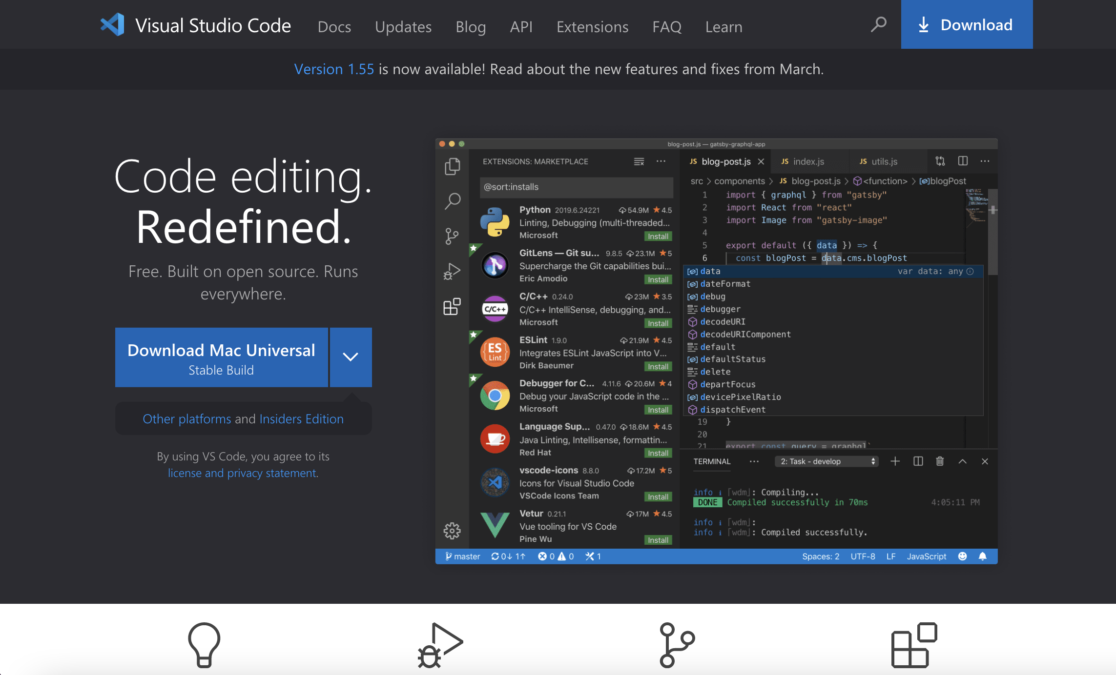
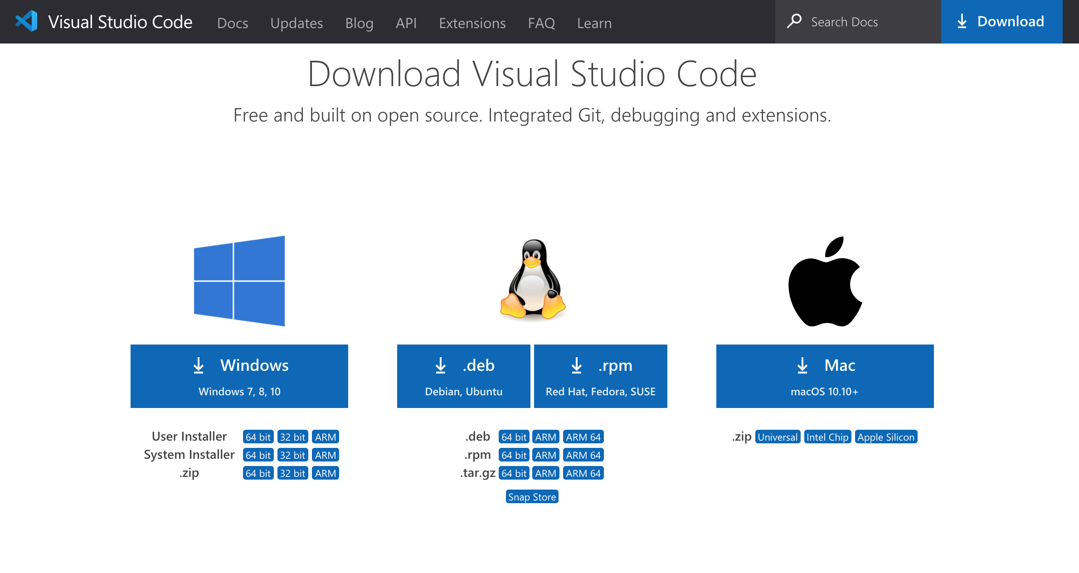
How to Install
Go to: https://code.visualstudio.com/download
Click “Download” at the top right
Choose the correct installer for your system

Slide 7
Comparison with the alternatives
 | VSCode | PyCharm | Atom | Eclipse | IntelliJ
Code Editor/IDE | Code Editor | IDE | Code Editor | IDE | IDE/Code Editor
Language Support | Python, Java, JS, C++, C#, .NET Core and many more | Python, JS, Coffee Script, HTML, CSS and Markup Languages | C++, Python, R, SQL, Java, JS | Java, Python, C, C++, C#, JS, | Java, Python, SQL, JS, HTML, Coffee Script
AutoComplete/Type Hinting/Linting/Syntax Highlighting | Yes, IntelliSense, own system | Yes, JetBrain’s system | Yes, own system | Yes, Codota | Yes, JetBrain’s system
Debugging | Includes debugging for supported languages | Includes debugging for supported languages | Includes debugging for supported languages | Includes debugging for supported languages | Includes debugging for supported languages
Extensions/Other Notable Features | A massive library of extensions,customizable, Built-In Git | Plugins, Intelligent code editor, built-in developer tools, smart code navigation, , Built-In Git | Extension packages, Re-mapping of key bindings, multiple coding panes, file system browser, ,Built-In Git | Extensions, Refactoring ,Docker tools, auto error reporting, Built-In Git | Plugins, Collaborative development, spelling/grammar checker, Built-In Git

Slide 8

An Example Coding Demonstration

Slide 9
Discussion/Questions to Think About
Should you use Visual Studio Code?
If you are looking for a production-level, lightweight, and customizable code editor that can support a large number of languages for any project, VSCode may be your best option
Would you like to use it in the future?
Sol: After having used it for the past two years, I have come to love the UI and all the features VSCode offers and will definitely continue to use it in the future
Milo: After having used it while working on this project, it is a code editor that I can definitely see myself using, especially as I continue to learn different languages aside from Python
Any challenges?
Sol: A great test of whether you really know something is if you can teach it to someone else. After having to do this presentation with different levels of background knowledge, I have come to realize my weaknesses when using VSCode and how much of a skill it is to teach others
Milo: I had some challenges with the user interface when transitioning to using VSCode at first, but there were multiple tutorials and walkthroughs that made it easily understandable after watching.

Slide 10
References
https://pypl.github.io/IDE.html
https://code.visualstudio.com/
https://www.jetbrains.com/pycharm/
https://atom.io/
https://www.eclipse.org/ide/
https://www.jetbrains.com/idea/

